Slide 1
CAPSTONE PROJECT
CREDIT CARD DEFAULTER PREDICTION
SHAJAD

Slide 2
Table of content
Objective
Data Summary
Data loading and exploration
Data Wrangling
Column wise analysis
Feature engineering
Hypothesis testing
Algorithm results
Algorithm that we use
Technique and methods we used
Challenges
Reference
Conclusion

Slide 3
Objective
In this project is aimed at predicting the case of customers default payments in Taiwan. From the perspective of risk management, the result of predictive accuracy of the estimated probability of default will be more valuable then the binary result of classification credible or not credible clints. We can use the K-S chart to evaluate which customers will default on their credit card payments.
Our objective is to conduct quantitative analysis on credit default risk by applying three interpretable machine learning models without utilizing credit score or credit history.

Slide 4
Data summary
Amount → Credit amount
Gender → Gender(1: Male , 2: female , 3:other)
Education → Educational qualifications(1: Graduate school, 2: university, 3:high school, 4: others )
Marital status → Married or not(1: Married, 2: Unmarried , 3: other
Age → Age
History of past payments → Payments made in past
Amount of bill statement → bill amount
Amount of previous payments → Previous amount paid(1: paid, 2: not paid)

Slide 5
Data loading
Data loading
Loading the data from google drive and read into notebook
Data exploration
Checking data in different column
Data operations
Cloumns
Numerical columns and the cetagorical columns
Data
Information and data type of columns

Slide 6
Data wrangling
Data wrangling-also called data cleaning, unifying messy and complex data sets to a meaningful format for easy access and analysis. There are various processes designed to transform raw data into more readily used formats.
*It includes following steps:
We change the label row because the first row is not readable.
Creating columns to better understanding.
Remove the columns that used to create the new columns.
Converting columns to proper data type format.
Adding or removing columns for analysis.
We sett the feature name with proper identification for better understanding
We also create a copy of data to avoid the mishapning.

Slide 7
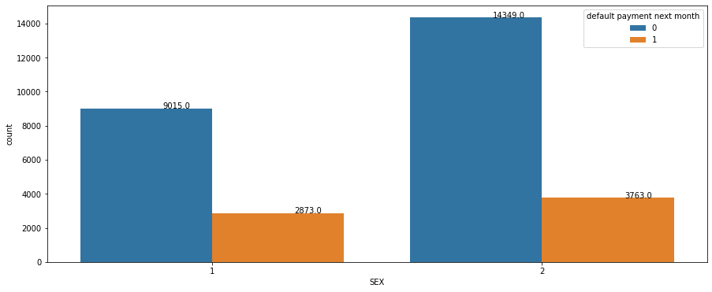
Column wise analysis
According to this chart there are 9015 male has no default but 2873 male customers are defaulted.
And 14349 female customers are not default but only 3763 female customer are defaulted.
So it means female customers has less default then the male customers.
There are 34% male are defaulter but 21% women customers are defaulter so women are more safest customer then men

Slide 8
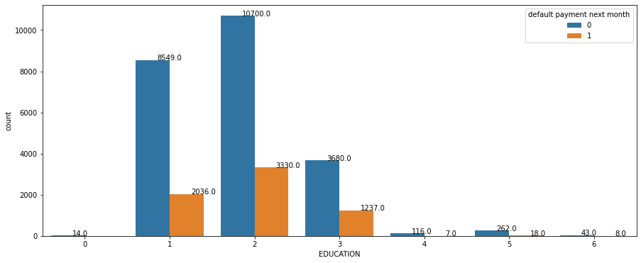
from the Graduate school There are 8549 customers are not defaulted but 2036 customers are defaulted. From the University there are 10700 customers are not defaulted but 3330 customers are defaulted. Fromm the High school there are 3680 customers are not defaulted and 1237 customers are defaulted. and other we include them in outliers. from graduate school have least defaulter that is 19% then University comes with 24% defaulters then High school comes with 25% defaulters

Slide 9
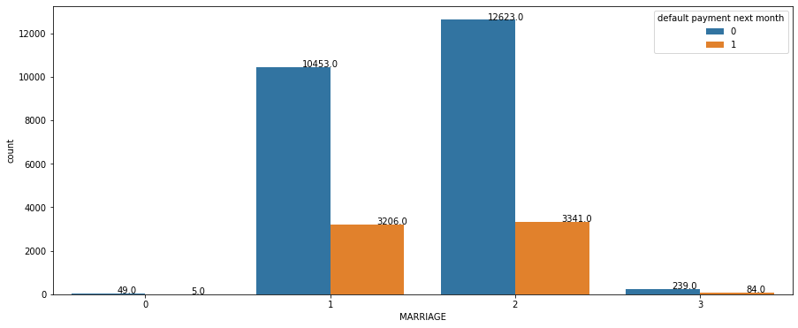
From the 1 there are 10453 married customers are not default and 3206 customers are defaulted.
From the single there are 12623 single customers are not default but 334 single customers are defaulted.
in this plot single customers are least defaulter with 21% then married customers are comes with 23.5% defaulters

Slide 10
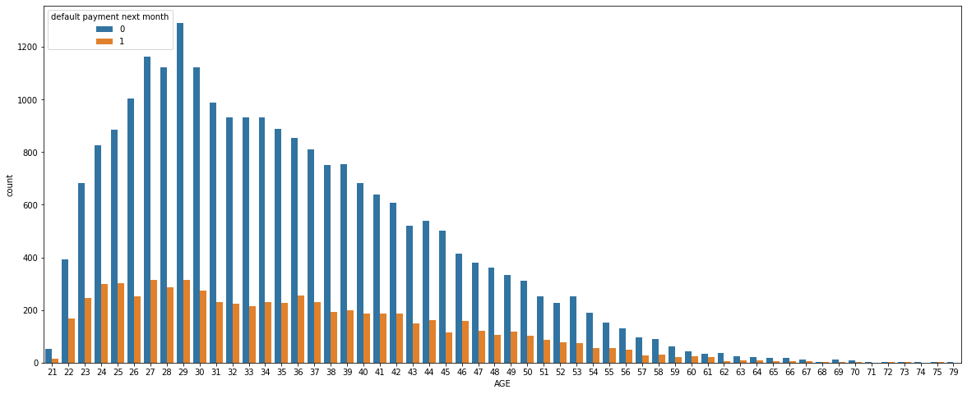
There are negative relationship between age credit card distribution increase in age that means the credit card holders is decrease.

Slide 11
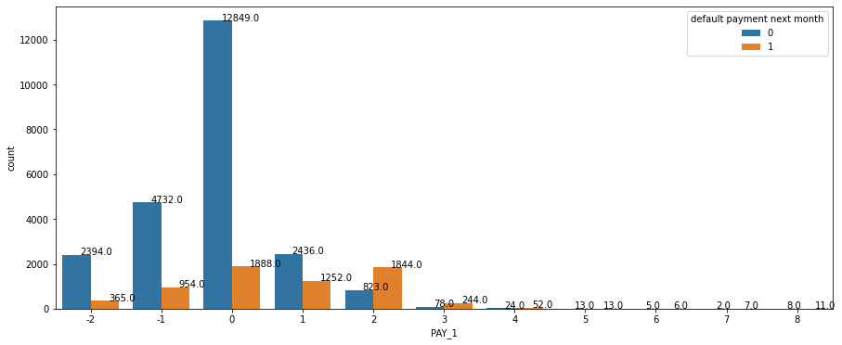
from -2(pay duly) there are 2394 customers are not default but 365 customer are default from -1(pay duly) there are 4732 customers are not default but 954 customers are defaulted. from 0(not duly) there are 12849 customers are not defaulted but 1888 customers are defaulted. from1(payment delay 1 month) there are 2436 customers are not defaulted but 1252 customers are defaulted. from 2 (payments delay 2 month)there are 823 customer are not defaulted but 1844 customer are defaulted. from 3(payment delay 3 month ) there are 78 customers are not defaulted but 244 customers are default. and so on.....

Slide 12
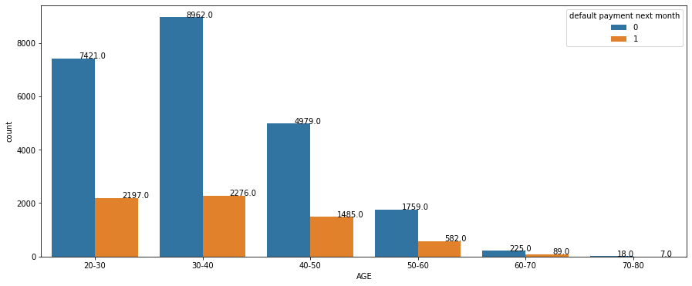
according to this chart
from the age group 20-30 There are 7421 customers are not defaulters but 2197 customers are defaulters.
from the age group 30-40 there are 9862 customers are not defaulters but 2276 customer are defaulters.
from age group 40-50 there are 4979 customers are non defaulter but 1485 customer are defaulters.
from age group50-60 there are 1759 customer are non defaulters but 582 customers are defaulter.
from the age group of 60-70 there are 225 customer are non default but 89 customer arre also defaulters.
according to this chart from age 60-70 the default percent 29% present in this group

Slide 13
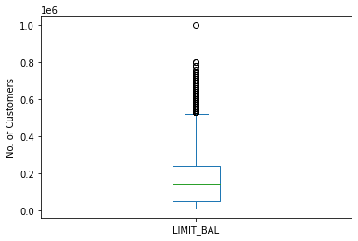
There are some outlier present in limitt balance

Slide 14
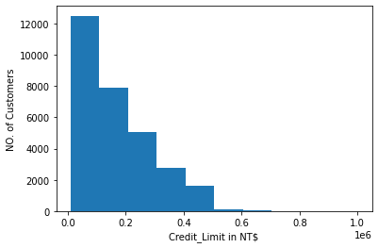
according to the plot there are some outlier present after the 50 % credit limit

Slide 15
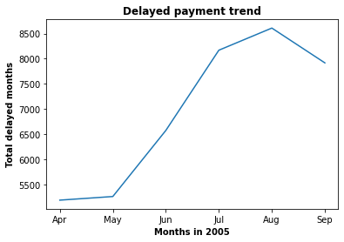
There are sharp upword trend between May to Aug and after Aug there is negative downword start

Slide 16
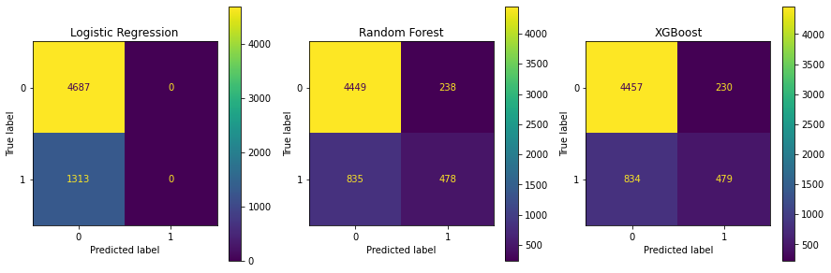

Slide 17
Feature Engineering
We convert Male and Female in sex column instaded of 1 and 2.
We make a copy of the data to secure our primary data and to avoid any mishapning
We convert 1 row to labels of data and delete the old labels of the data for batter understanding.
We delete the duplicate columns.
We remove the unnecessary data points.
We add and delete the some columns.
We check the data imbalance.
We split the data into Train dataset and the test dataset

Slide 18
Algorithm that we use
1st we use Logistic Regression
2nd we use Random Forest
3rd we use XG Boost

Slide 19
Hypothesis and result
1
Null hypothesis (1) : Credit limit does not affect default likehood.
Alternative hypothesis(1) : Credit limit impact likehood.
RESULT(We get a p value as 0, therefore we need to reject the null hypothesis and accept the alternative hypothesis. Credit limit has an impact on payment default.)
2
Null hypothesis(2) : Education does not affect default likehood.
Alternative hypothesis(2) : Education impact default likehood.
RESULT (Since the p value is close to 0, we will reject the null hypothesis and accept the alternative hypothesis. Because education has a strong correlation with default probability, we should keep this variable in the machine learning model.)
3
Null hypothesis(3) : Age dose not affect default likehood
Alternative hypothesis(3) : Age impact default likehood
RESULT (The p value is smaller than significance level , we will reject the null hypothesis and accept the alternative hypothesis, which is age has impact on default probability.)

Slide 20
Algorithm result
NO. | Algorithm | Precision | Recall | F1 Score | Conclusion
1 | Logistic Regression | nan | 0 | nan | Benchmark
2 | Random forest | 0.668 | 0.364 | 0.471 | Good
3 | XG Boost | 0.676 | 0.365 | 0.475 | Best Model
4 | Dummy | 0.217 | 0.223 | 0.220 | Benchmark

Slide 21
Technique and methods we used
1st we decide the X variables and the Y variables
Then we divide the data into 2 parts Train dataset and the test dataset
And we took the 80 percent data as training data and 20 percent data as a test data
Abd we use the standard scaler as a scaler
Metrics that we are use in this project is 1)Precision, 2)Recall, 3)F1 Score, 4)ROC_AUC.
In this project we use Logistic Regression, Random Forest, XG Boost and Dummy algorithm.

Slide 22
Challenges
When we start this project the data is very complex and not easy to under stand.
In this project the best part is to plotting the right plot and find the inside information about the features.
After plot the graph we do some feature engineering and make some columns and some colums also delete.
And finally we apply the algorithm on the data

Slide 23
Conclusion
This project is about the Credit card default prediction analysis. When we start this project it is very difficult to understand and look very complex. In first step we upload the data and then we start to find the duplicate values and nulls values and missing values etc. but in this data there is no missing values and duplicate values. After completion of 1st step in 2nd step we plot the data in form of graph, pie plot and bar plot and line plot and also box plot, and in box plot we find some outlier but these outliers are not affect the result because thy are very less in number. After plot the data we plot the heatmap of the data and then we find the relationship between the feature and we did some feature engineering in the data. We remove the labels of the data because that labels are not readable and difficult to understand and we make the data’s 1st row as the labels of the data. After the feature engineering we apply some algorithm, 1)Logistic Regression , 2)Random forest ,3)XG Boost and we also use the dummy model to describe the our model and make them easy to under stand. And we also do the some cross validation in every algorithm. After applying these algorithm we select the Random Forest as a best algorithm that gives the best score. It gives the precision 0.668 and recall 0.364 and F1 score 0.471 percent. After selecting the algorithm we do some feature engineering and do some cross validation but there is not much change in the result. Logistic Regression model has the highest recall but the lowest precision, if the business cares recall the most, then this model is the best candidate. If the balance of recall and precision is the most important metric, then Random Forest is the ideal model. Since Random Forest has slightly lower recall but much higher precision than Logistic Regression, I would recommend Random Forest.

Slide 24
Reference
Almabetter
Geeksforgeeks
StackOverflow
Github

Slide 25
THANK YOU

